Slide 1

Drive care – A Driver Drowsiness Detection system
Presented in the partial fulfilment of the mAJor project(MID-SEMESTER) UNDER THE GUAIDANCE OF DR.AJISHEK RAJ SIR
at
National Institute of Technology, Patna

Slide 2
TEAM
2002076 – Umma Jaswanth Reddy
2002028 – Mallela Srujana
2002052 – Bhukya Gopi Krishna
2002032 – Kalyani Maloth

Slide 3
TABLE OF CONTENTS
PROBLEM STATEMENT
INTRODUCTION
- OBJECTIVE
APPROACH
- TECHNOLOGIES USED
- ALGORITHM
RESULTS
EVALUATION
CONCLUSION
REFERENCES

Slide 4
PROBLEM STATEMENT
According to the record of National Sleep Foundation released on Drowsy Driver prevention Week (November 5-11 2023), about 32% of drivers have at least one drowsy driving experience per month.
About 25% of traffic accidents involve drowsy driving every year
To prevent sleepy driving, a series of laws and regulations are enacted all over the world.
However, this method cannot detect whether a driver is fatigued or not in real-time
With the development of information technology, detection system for drowsiness driving has become an alternative means to solve the problem

Slide 5
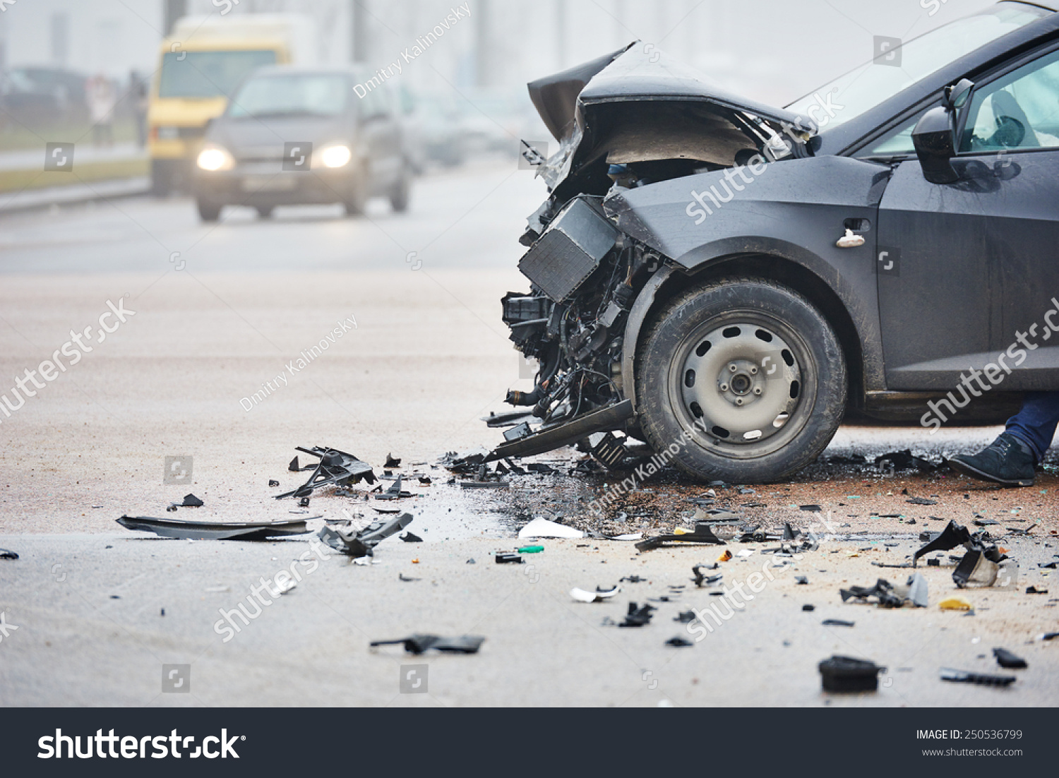
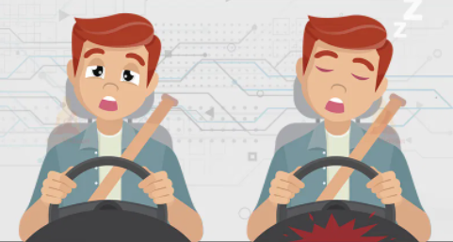
DROWSY DRIVER – Prone to Accidents

Slide 6
SOME STATISTICS ABOUT ACCIDENTS DUE TO DROWSY DRIVING
21 percent of all fatal accidents are due to drowsy driving.
60 percent of adult drivers or about 168 million people have driven a vehicle while feeling drowsy in the past year.
40% of highway accidents occur due to drivers dozing off

Slide 7
INTRODUCTION
we have made a drowsiness detecting system which alerts the driver when he is Drowsy or yawning.
An infinite number of people travel daily which includes the bus drivers, taxi drivers and private cars as well.
It has been observed that majority of the accidents happening on the roads are due to the fatigue state and drowsiness of the driver.
So, we have built a system using Python, OpenCV and dlib to detect the drivers face and alert him in case drowsiness is detected.
The objective of this project is to build a drowsiness detection system that will detect a person’s eyes and will alert the driver when drowsiness is detected.
A computer vision system that can automatically detect driver drowsiness in a real-time video stream and then play an alarm if the driver appears to be drowsy.

Slide 8
DIFFERENT WAYS TO DETECT DROWSINESS
Electrocardiogram (ECG) and electroencephalogram (EEG)
The heart rate varies significantly between the different stages of drowsiness.
Therefore ECG signal is used to determine the heart rate and is also used to detect drowsiness.
Eye Blinking Based Technique
In this technique the eye blinking rate and eye closure duration is measured to detect driver’s drowsiness.
Yawning Based Technique
This technique detects the mouth region and determines when the driver yawns or opens his mouth in order to gain more supply of oxygen.
Optical Detection
The most efficient and common implementation of an optical sensor system uses infrared or near infrared LEDs to light the driver’s eyes and are then monitored by a camera system to determine the drowsiness.

Slide 9
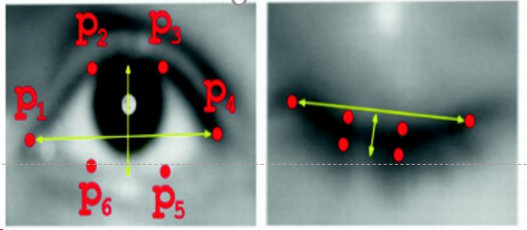
IDEA WE FOLLOWED
There are six landmarks(P1,P2,P3,P4,P5,P6) for representing each eye, Starting from the left corner moving clockwise and 6 points on lips are considerd.
A blink is supposed to last 200-300 milliseconds
A drowsy blink would last for 800-900 milliseconds
Using the 6 points , Eye aspect ratio (EAR) is calculated

Slide 10
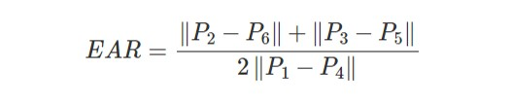
Eye Aspect Ratio (ear)
Eye Aspect Ratio (EAR) can be computed according to the position of eyes landmarks by:
The eye is open if Eye Aspect ratio is greater than threshold. (Around 0.25)
The eye is closed or partially closed if Eye Aspect Ratio is less than the threshold. In this case, the user is given an ‘alert’.
The same applies for yawning

Slide 11
FOR Yawning
Similar to the 6 land marks considerd on eye we consider 6 land marks on the lips
if the person yawns for more than Fifteen seconds then drowsiness is detected

Slide 12
Technologies and libraries used
Python
Open CV
Dlib
Imutils

Slide 13
open cv And dlib
OpenCV stands for Open Source Computer Vision. To put it simply, it is a library used for image processing. It is a huge open-source library used for computer vision applications, in areas powered by Artificial Intelligence or Machine Learning algorithms, and for completing tasks that need image processing.
Dlib Is a landmark's facial detector with pre-trained models, the dlib is used to estimate the location of 68 coordinates (x, y) that map the facial points on a person's . These points are identified from the pre-trained model

Slide 14
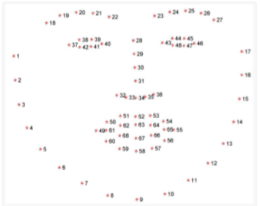
Facial Landmarks

Slide 15
ALGORITHM
Create facial landmark detector which is defined in dlib library to estimate the location of 68 (x, y)-coordinates that map to facial structures on the face.
Get the indexes of facial landmarks of left eye and right eye.
Start the video stream thread.

Slide 16
algorithm
Then loop over frames from the video stream.
Get the frame from the threaded video file stream, resize it, and convert it to gray scale channels.
Detect faces in the grayscale frame.
Loop over the face detections.
Determine the facial landmarks for the face region, then convert the facial landmark (x, y)-coordinates to a NumPy array.
Extract the left and right eye coordinates, then use the coordinates to compute the eye aspect ratio for both eyes.
Average the eye aspect ratio together for both eyes.
Check to see if the eye aspect ratio is below the blink threshold [0.25], and if so, increment the blink frame counter. Else, set the blink frame counter value to 0.
If the eyes were closed for a sufficient number of frames [30 frames], then sound the alarm.

Slide 17
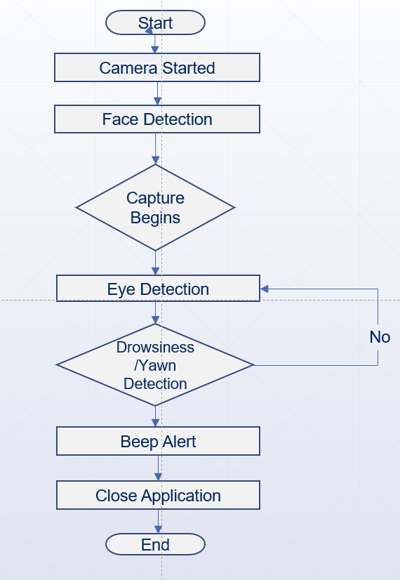
Work flow

Slide 18
Result

Slide 19
Result

Slide 20
FURTHER Work FOR END SEMESTER
As of now we have completed the software part of the project but its complex to use the laptop in a vehicle
We are going to develop a hardware using which can be installed in a vehicle very easily

Slide 21
THANK YOU
.

